Slide 1


SEED CERTIFICATION USING ARTIFICIAL INTELLIGENCE

Slide 2
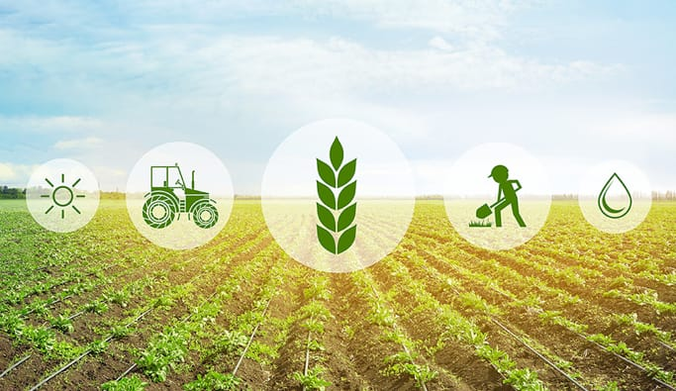
TABLE OF CONTENT
1.Information
2.Problem statement
3.Introduction
4.Need of innovation
5.Novelity
6.Feasibility
7.Companies using agricultural block chain
8.Market Value
9.Scalability of technology
10.Risk assessment
11.Impact
12.Conclusion
13.Team name and leader

Slide 3
PROTOTYPE DEMO
https://drive.google.com/file/d/1oPqzXPOdX9zOa3Iej8Me7tc_u5sLyw0_/view?usp=sharing

Slide 4
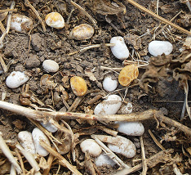
PROBLEM STATEMENT
Seed supply chain is a complex ecosystem involving stakeholders
Seed quality issues have been demanded a need for effective traceability solution.
Several important criteria such as color ,crack, bacterial infection ,origin of the seed , stages in production , conformance to quality standard such as genetic purity , germination rate are to be validated

Slide 5
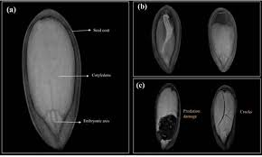
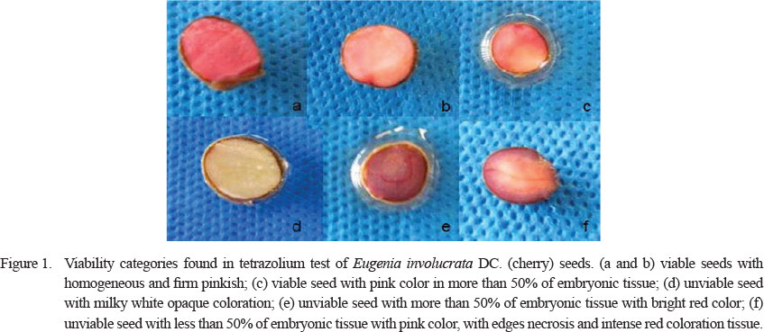
Need of Innovation
Efficiency of seed testing labs .
Lack of effective Monitoring Mechanism.
Production and Brand Imaging .
Capacity and storage of seed.
Cost effective tool and less man power intensive.
Enhances testing time

Slide 6
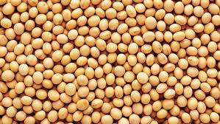
INTRODUCTION
43 million hectares are used for maize seed .
Major requirement for 1.29 millions tons of certified seed & 0.43 million labs for seed productions.
Monitoring of 130 seed laboratory and 718 seed testing districts in the country is difficult task .
Every Seed Laboratory have more than 5-6 districts , for which is physically seeding test is impossible.
Seed quality consequently requires the need to control and monitor the testing seeds
By using this method we can obtain efficient results within short span of time , which will be useful for seed testing labs

Slide 7
SCALABLITY
Cloud based services and enabling existing data center and
infrastructures to use the technology from any place, based on the
demand.
Improves capital optimization, Reduces counterparty risks, Improved.
Instant verification of the seed quality based on the provided data
Faster and more efficient method to test the quality of the seed

Slide 8
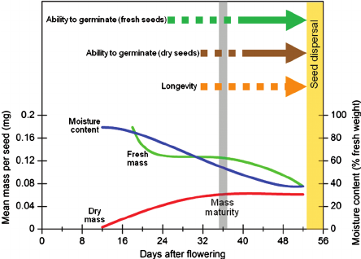
Feasibility
Samples of the seed are taken uniformly .
30 days is taken in laboratory to test the samples of the seeds
The data of the samples of rice seed is stored in cloud computing after germination test
Technically feasible

Slide 9
NOVELITY
Traditional germination testing .
Artificial Intelligence based convolutional neural network used to detect the features of seed.
This method will replace time consuming physical grow up methods.
The automated Data will be stored in distributed cloud technology algorithms.

Slide 10
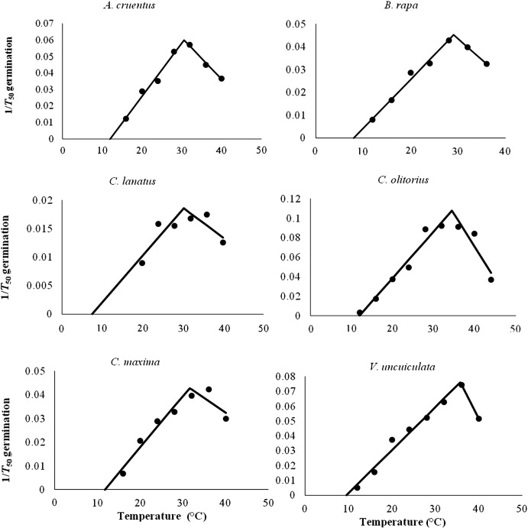
IMPACT
130 Labs and 700 testing's reduces the time for testing and accuracy
10% improvement of quality of seed and increase in income
Increase in accuracy seed quality & easily sorting principles are used by using ANN.
Temperature is main factor for seed germination
The increase in growth seed production 14 billion USD by 2025 using block chain technology

Slide 11
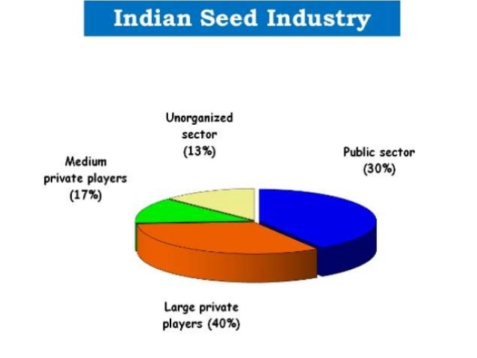
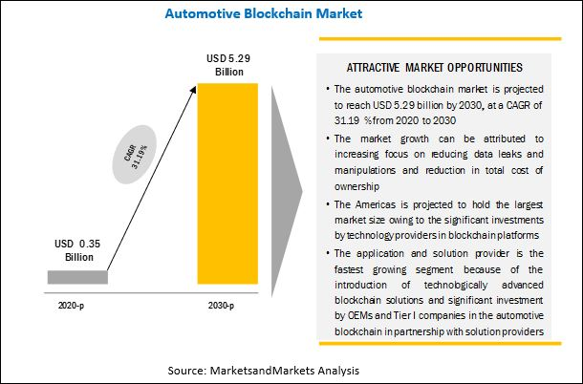
MARKET VALUE
0.43 million of maize seeds is about Rs.35 per kg In the market prices. 1.29 million tons of paddy seeds @ Rs.35 per kg makes it Rs 4,515 crore market.
Seed testing is tremendous based on seed samples of annual basis of the customers for the upfront payment of state government.
Revenue will be generalized based on the samples of the seed .
Market value is based on Annual basis of the customers (State Government).
Indian seed estimation reaches value of $3.6 billion in 2020 growing annual rate of CAGR of around 17 percent.
Distributed ledgers and other block chain capabilities are rapidly expanding financial benefits.

Slide 12
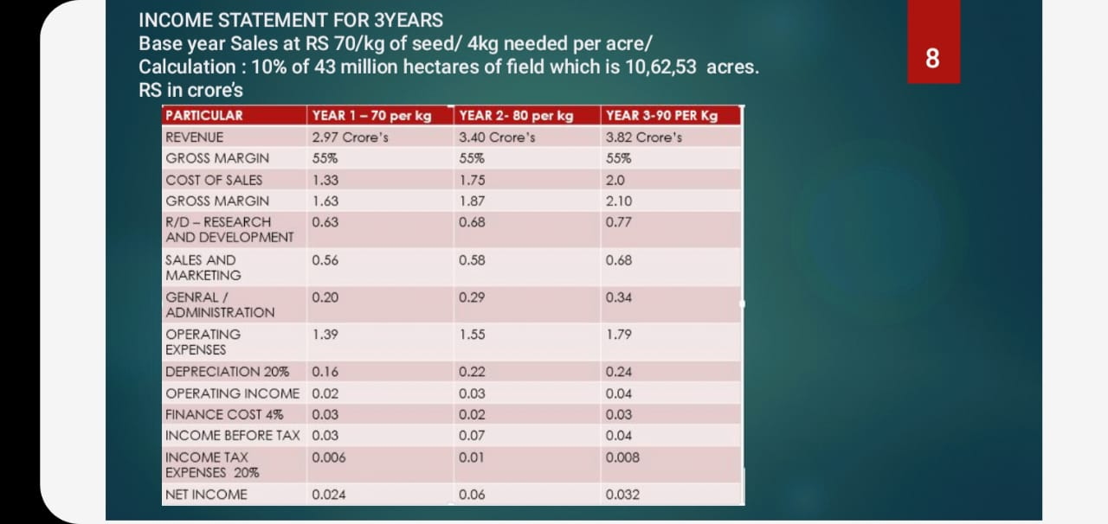
BUSINESS PLAN – REVENUE BASED

Slide 13
BUSINESS MODEL
Model allows the customer – Seed certifying agency to use the services by paying the fixed amount for every 1kg of seed sample after testing the seed.
Every 1 kg of seed samples cost Rs.15 for Automated AI based software support for testing bulk quantity of seed in less time period
Instant payment after testing 1 kg of seed will be done using block chain technology.
1 kg of seed with annual subscription cost for using seed testing software varies according to the type of seed data being used.

Slide 14
UNIQUE SELLING PROPOSITION
1.Mobile friendly application
2. Easy to use
3. Affordable by farmers – End user
4. Less time consumption for testing
5. Faster and accurate results
6. Bulk testing

Slide 15


TEAM MEMBERS
Melvin Abraham. Jeshron Sonali.A Role : UI design Role : Documentation & solution to the problem B.Tech CSE department, B.Tech ECE department,
3 rd year SRM UNIVERSITY, 3 rd year SRM UNIVERSITY,
Chennai . Chennai.

Slide 16


Min oviya S. Akhil Sanker Role : idea implementation & documentation. Role : AI deployment and API development B.Tech ECE department, B.Tech CSE department 3rd year SRM UNIVERSITY,. 3rd year SRM UNIVERSITY CHENNAI. CHENNAI

